Slide 1
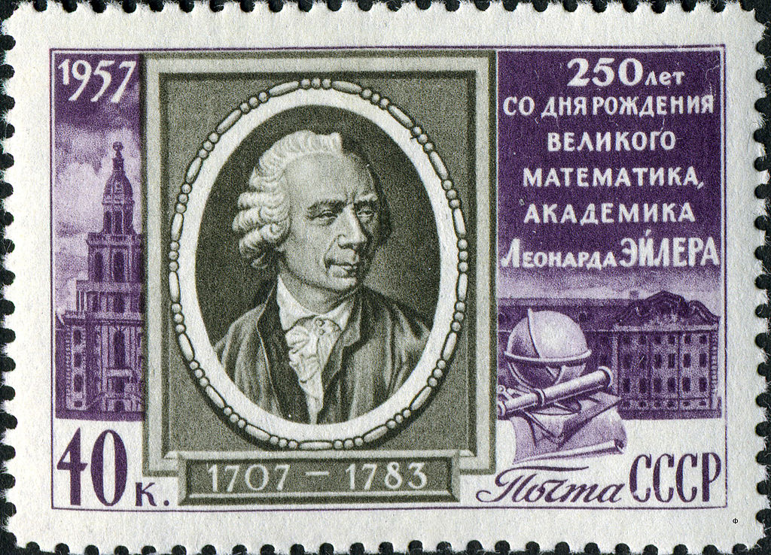
MCB 135 Lecture 5 Introduction to modeling and common simplifying assumptions
k₁
A
2B
k₋₁
k₂
D
A + C
k₋₂
k₃
k₄
B + E
Notes:
Walter Pitts, John von Neumann

Slide 2
Logistical issues
Selecting a paper discussion time
Problem Set 1 has been posted and is due at 2:30 PM on Monday, February 9 (note time error in previous lecture slides)
Getting help with the first problem set
Lecture videos through Monday now online
For a link to the lecture 2 file, click on Modules -> Lecture 2

Slide 3
Recap: Lessons from gene regulation
Cannot treat all changes as instantaneous and all concentrations as booleans.
Need to study the dynamics of (quasi)continuous concentration changes
Gene regulation, like many biological processes, takes place through chemical reactions
The Law of Mass Action explains chemical reaction rates

Slide 4
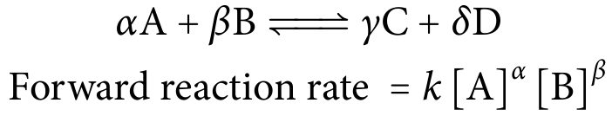
Recap: Law of Mass Action
“Kinetic order”
of B
Mass action rate constant (usually written above the reaction arrow)
Applies to elementary reactions, not composite reactions
The slowest “rate-limiting” elementary reaction effectively sets the composite reaction rate
Catalysts like enzymes work via composite reactions
On Friday, we will learn to deal with them using Michaelis-Menten kinetics

Slide 5
How do we apply the Law of Mass Action to study system dynamics?
Notes:
Suppose we’ve already sorted out which reactions are

Slide 6
Today’s Outline
Differential equation models for reaction networks
Constraints from conservation
Reducing complexity using separation of timescales
Effective constancy assumptions
Rapid equilibrium assumptions
Quasi-steady-state assumptions
Visualizing system dynamics
Numerical integration techniques
MATLAB demo
Notes:
Once we’re done with this, you’ll be ready to tackle problem set 1.

Slide 7
Example: Radioactive decay
c₁
A
B
Reaction rate: c₁[A]
Rate of change in [A]: d[A]/dt = -c₁[A]
Rate of change in [B]: d[B]/dt = c₁[A]
Can we find an analytical solution?
Notes:
We will grow tired of writing the concentration brackets around everything.

Slide 8
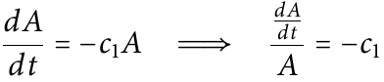
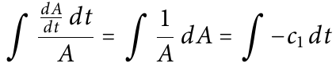
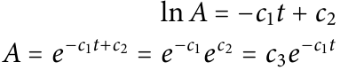
Example: Radioactive decay
c₁
A
B
Notes:
We will grow tired of writing the concentration brackets around everything.

Slide 9
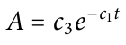
Example: Radioactive decay
c₁
A
B
What is the physical interpretation of c₃?
At time zero: A(0) = c₃ e⁰ = c₃
In other words, c₃ is just the initial concentration of A.
Notes:
We will grow tired of writing the concentration brackets around everything.

Slide 10
Example: Radioactive decay
c₁
A
B
We have an expression for A: how do we get an expression for B?
One option: plug in and integrate
Rate of change in [B]: d[B]/dt = c₁[A]
The easier way: exploiting moiety conservation
Notes:
In this particular instance, A

Slide 11
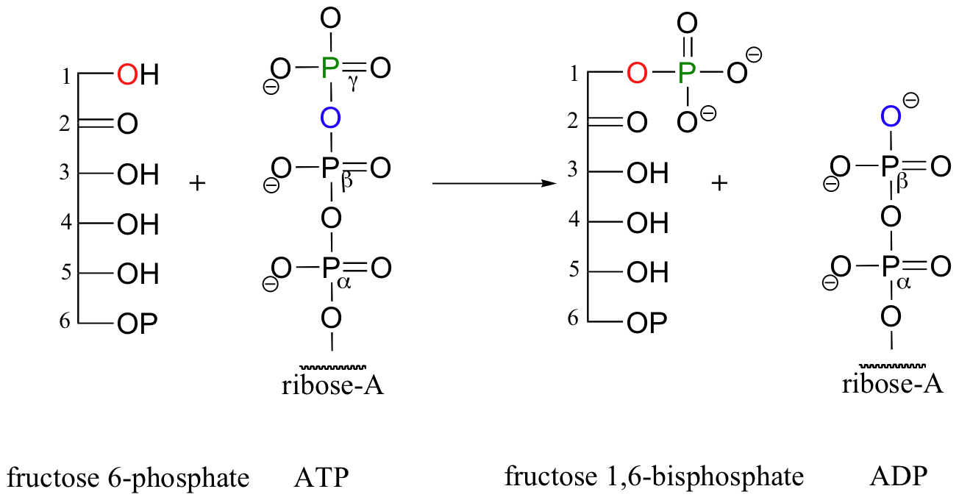
Moiety conservation restricts how concentrations change together
[F6P] + [F1,6BP] = constant
[ATP] + [F1,6BP] = constant
[ATP] + [ADP] = constant

Slide 12
Example: Radioactive decay
c₁
A
B
We have an expression for A: how do we get an expression for B?
The Easy Way (exploiting moiety conservation):
A and B share something in common called a moiety.
Physical interpretation: the moiety is the atom A, minus whatever gets emitted during the decay.)
None of the moiety enters or exits the system, so:
[A] + [B] = c₄
[B] = c₄– [A] = c₄ - c₃e^{-c1t}
Notes:
In this particular instance, A

Slide 13
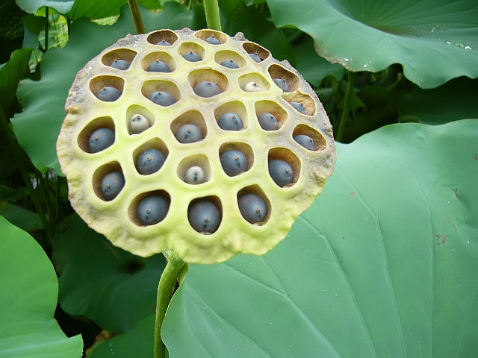
Living things are often leaky
Two types of “pseudoreactions:”
Generation or addition to the system:
c₁
Ø
A
Removal, degradation, or dilution:
c₂
B
Ø
Notes:
Dilution is an especially important case for biology. Many cells grow in volume and divide, which dilutes existing proteins unless new ones continue to be made.

Slide 14
Example: A more complicated chemical reaction network
k₁
k₂
A
2B
D
A + C
k₋₁
k₋₂
2B
A
A + C
D
(homodimerization and reseparation)
(heterodimerization and reseparation)
k₃
Irreversible disintegration
D
B + E
k₄
Irreversible conversion
B + E
A + C
Example from Gunawardena 2003
Notes:
Point out how the mass action rate coefficients for reversible reactions often have negative subscripts for the reverse reaction.

Slide 15
Example: A more complicated chemical reaction network
k₁
A
2B
k₁
k₋₁
A
2B
2B
A
k₋₁
k₂
D
A + C
k₂
k₋₂
D
A + C
A + C
D
k₋₂
k₃
k₃
k₄
D
B + E
k₄
B + E
B + E
A + C
Notes:
Point out how the mass action rate coefficients for reversible reactions often have negative subscripts for the reverse reaction.

Slide 16
Example: A more complicated chemical reaction network
Find two moieties in this system.
Determine their conservation relations.
k₁
A
2B
k₋₁
k₂
2[A] + 2[D] + [B] + [E] = constant
[D] + [C] + [E] = constant
D
A + C
k₋₂
k₃
k₄
B + E
Notes:
Point out how the mass action rate coefficients for reversible reactions often have negative subscripts for the reverse reaction.

Slide 17
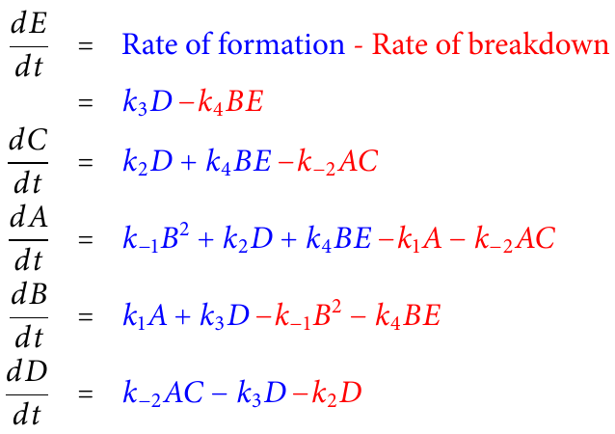
Example: A more complicated chemical reaction network
k₁
A
2B
k₋₁
k₂
D
A + C
k₋₂
k₃
k₄
B + E
Notes:
Get some student participation here.

Slide 18
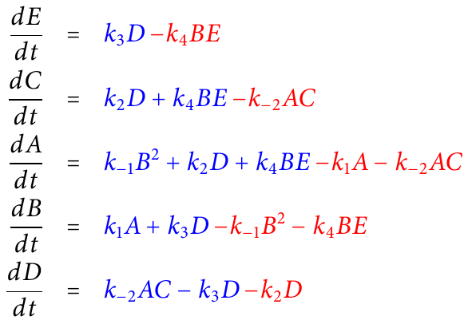
Example: A more complicated chemical reaction network
This system of ODEs:
Is non-linear

Slide 19
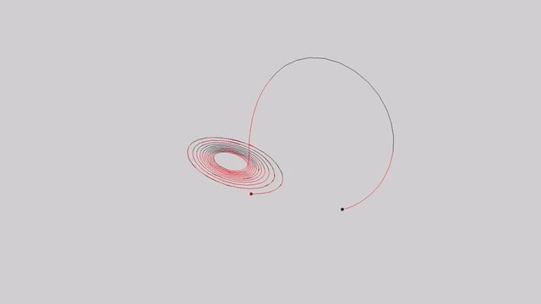
Example: A more complicated chemical reaction network
This system of ODEs:
Is non-linear
Has five species
The Lorenz attractor
Notes:
Point out how the mass action rate coefficients for reversible reactions often have negative subscripts for the reverse reaction.

Slide 20
Example: A more complicated chemical reaction network
This system of ODEs:
Is non-linear
Has five species
Has six parameters (the mass action rate constants)
Notes:
Point out how the mass action rate coefficients for reversible reactions often have negative subscripts for the reverse reaction.

Slide 21
How can we simplify chemical reaction networks?

Slide 22
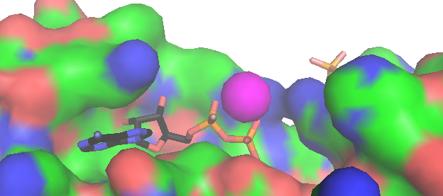

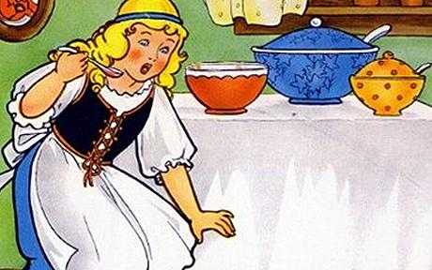
Exploit separation of timescales
We choose a timescale of interest:
Anything that changes more rapidly, we assume has already reached steady-state.
Anything that changes more slowly, we approximate as constant.
Too fast
Too slow
Just right
Notes:
Rule of thumb: an order of magnitude difference is enough.

Slide 23
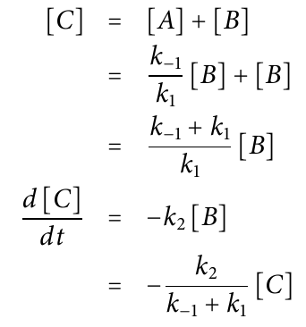
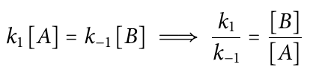
Assume fast processes have reached equilibrium
We can simplify the system down to “one species”:
k₁
k₂
A
B
Ø
k₋₁
k₁, k₋₁ >> k₂
A and B are in rapid equilibrium:

Slide 24
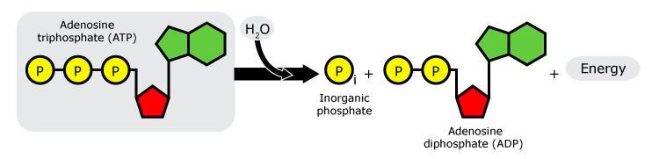
Eliminate molecular species whose concentrations are effectively constant
Homeostasis buffers the concentrations of critical molecules, e.g. the ATP:ADP ratio
We can also ignore changes that are small relative to absolute concentration (at least initially):
e.g., a reaction rate = k₁[ATP][E] ≈ k₁’[E], where k₁‘ = k₁[ATP]_{s-s}
e.g., a reaction rate = k₁[A][B] ≈ k₁’[A], if [B] is fairly constant
These are called “pseudo-first-order” reactions
Notes:
In class on Monday, we saw that ATP can donate a phosphate group to other molecules. ATP functions in another important way

Slide 25
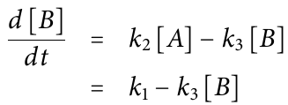
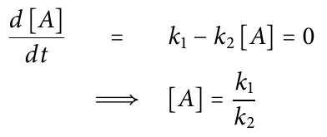
Alternatively, assume a species’ concentration is at steady-state
k₁
k₂
k₃
Ø
A
B
Ø
Assume [A] is at steady-state.
Notes:
Called the quasi-steady-state assumption/

Slide 26
As they come up in the course, we’ll discuss two other methods:
Nondimensionalization (reduces parameter number)
Linearization (clarifies behavior near points of interest)

Slide 27
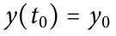
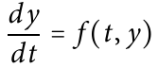
Visualizing changes with time
How to plot y(t), when you only have:
An initial condition,
An ODE,
Often there may be no dependence of f on the time t (the laws of mass action aren’t time-dependent)

Slide 28
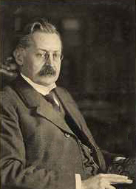
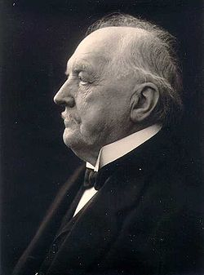
Good enough (?) numerical integration of ODEs

Slide 29
Euler’s method
Want to plot y(t), but only have:
An initial condition,
An ODE,
Start from initial condition and take a small step based on the slope there.
Take another small step based on the slope at that point…and so forth.

Slide 30
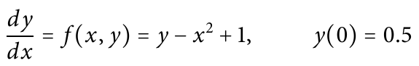
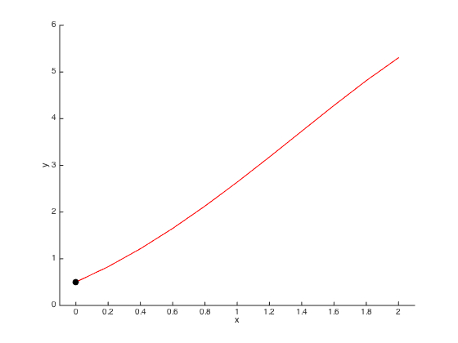
Example:
Analytical solution
How much will the dotted line rise as x increases by 0.2?
y(0.2) ~ y(0) + 0.2 * f(0, 0.5)
~ 0.5 + 0.2 * 1.5 = 0.8
Initial slope f(0, 0.5) = 1.5
Initial condition

Slide 31
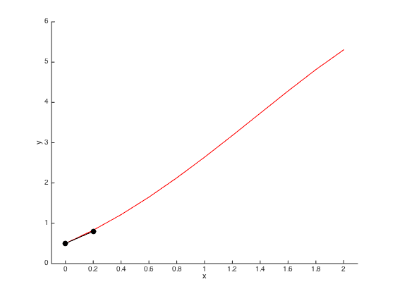
Example:
Analytical solution
How much will the dotted line rise as x increases by 0.2?
y(0.4) ~ y(0.2) + 0.2 * f(0.2, 0.8)
~ 0.8 + 0.2 * 1.76 = 1.152
Slope f(0.2, 0.8) = 1.76
y(0.2) ~ 0.8

Slide 32
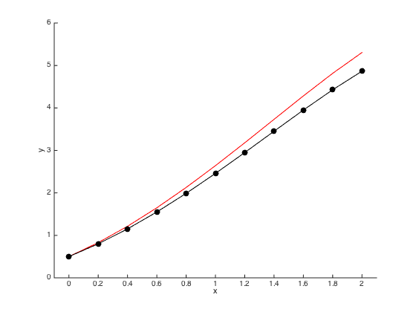
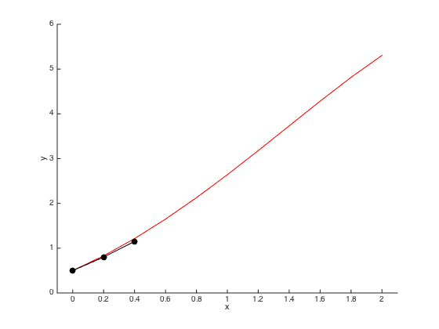
Example:
Analytical solution

Slide 33
Example:
Analytical solution

Slide 34
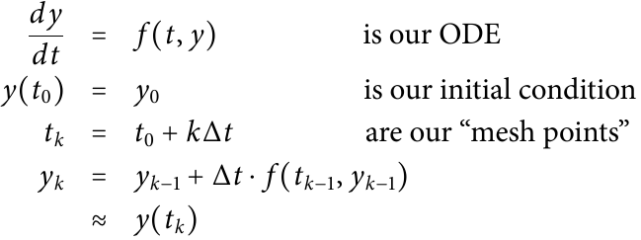
Algorithm for Euler’s method
Notes:
The formula for y_k is applied iteratively: first y_1 is calculated using the initial conditions, then we have enough information to calculate y_2, etc.

Slide 35
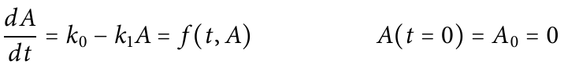
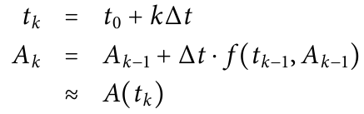
Let’s apply this to a simple production and decay example
k₀
k₁
A
Notes:
a(t) is the concentration of A at time t

Slide 36
Let’s apply this to a simple production and decay example
k₀
k₁
A
Slope decreases to zero as A → k₀/k₁
Concentration of A
Initial slope is k₀
Time
Notes:
a(t) is the concentration of A at time t

Slide 37
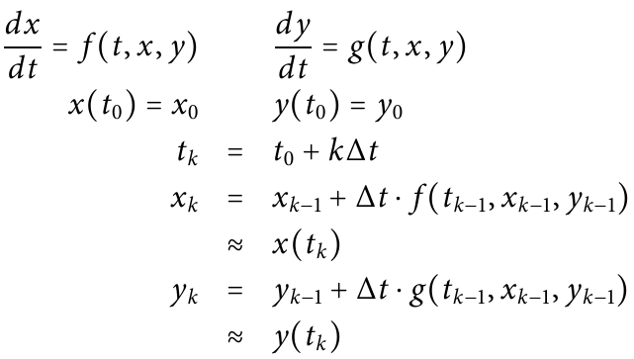
What if our system has more than one molecular species?

Slide 38
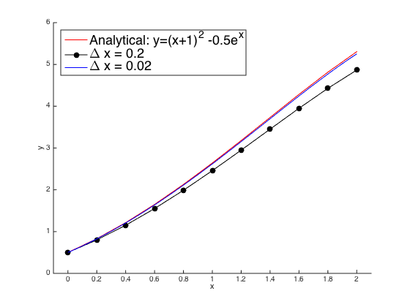
Smaller step sizes give more accurate results
Notes:
Might be unclear in advance how small this interval needs to be chosen for the result to be acceptable (guidelines for general classes of equations exist). In practice, because we don’t have to do it by hand, we can just opt for very small increments.

Slide 39
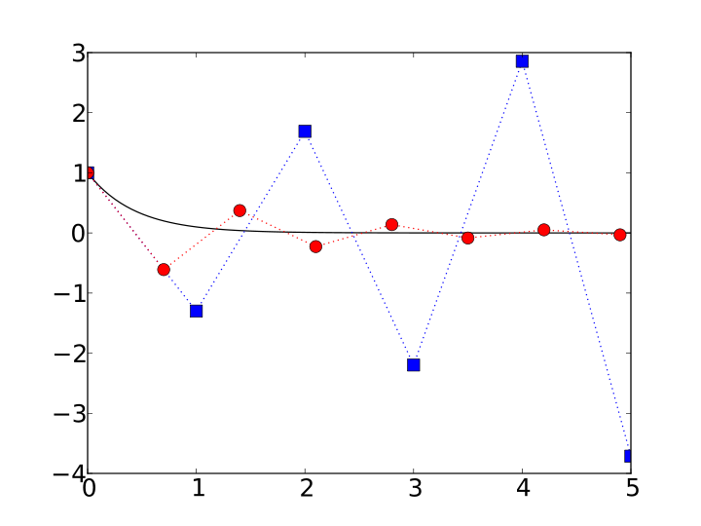
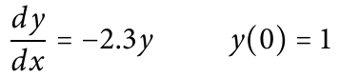
Oscillations and instability can result from overly large step sizes
Analytical solution
Δx = 1
Δx = 0.7

Slide 40
An improvement on Euler’s method: estimating the slope at multiple places within each interval The Runge-Kutta methods [e.g. ode45() in MATLAB] do this

Slide 41
Runge-Kutta in action
Initial slope “m₁”
x₀
x₁

Slide 42
Runge-Kutta in action
Guess the value at the midpoint, assuming m₁ is correct
x₀
X_{0.5}
x₁
Notes:
Guess the midpoint

Slide 43
Runge-Kutta in action
Calculate the slope there, “m₂”
x₀
X_{0.5}
x₁
Notes:
Guess the midpoint

Slide 44
Runge-Kutta in action
Guess the value of the midpoint again, assuming m₂ is correct for the interval
x₀
X_{0.5}
x₁
Notes:
Guess the midpoint

Slide 45
Runge-Kutta in action
Calculate the slope there, “m₃”
x₀
X_{0.5}
x₁
Notes:
Guess the midpoint

Slide 46
Runge-Kutta in action
Guess the value of the endpoint, assuming m₃ is correct for the interval
x₀
X_{0.5}
x₁
Notes:
Guess the midpoint

Slide 47
Runge-Kutta in action
Calculate the slope there, “m₄”
x₀
X_{0.5}
x₁
Notes:
Guess the midpoint

Slide 48
Runge-Kutta in action
m = (m₁ + 2m₂ + 2m₃ + m₄)/6
Take a weighted average of those four slopes and use it to predict the endpoint
x₀
X_{0.5}
x₁
Notes:
Guess the midpoint

Slide 49
Using the Runge-Kutta method in MATLAB
Define a function that returns the instantaneous rate of change for each variable
Call the ode45() function with:
The name of your function, e.g. @myfunction
The time range that interests you
The initial concentrations of all molecular species
Demo in MATLAB (tutorial in Ingalls, appendix C)
Also ported to Python, see course website

Slide 50
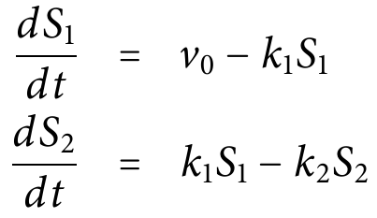
MATLAB Demo
v₀
k₁
k₂
Ø
S₁
S₂
Ø
Initial conditions: S₁(0) = 1 μM, S₂(0) = 0 μM
Parameter values: v₀ = 5 μM min⁻¹
k₁ = 3 min⁻¹
k₂ = 2 min⁻¹ Goal: plot concentrations over the first five minutes.

Slide 51
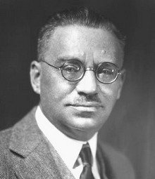
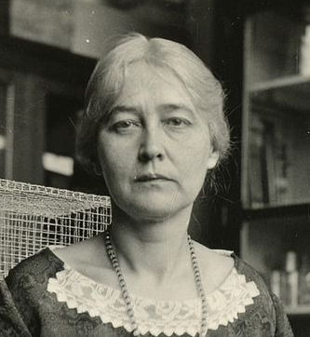
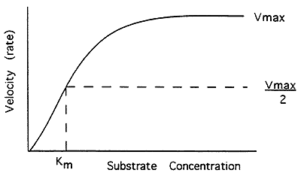
Next time:
Enzyme kinetics

